Slide 1
22/04/2021
NEW ROLE SCHOOLS
DATA SCIENTIST
Edition 4 | Group 2
PROJECT WORK PRESENTATION
YOUR WAY TO THE FUTURE

Slide 2
Agenda
1
Team Composition
2
How we worked together
3
Overview of the entire process and data insights obtained from setup and loading
4
Sentiment Analysis
5
Exploratory Data analysis (EDA)
6
Modelling
7
Business Case
8
Target model – Call to Action

Slide 3
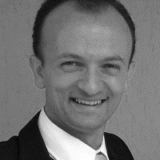


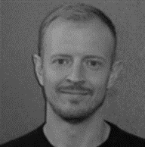
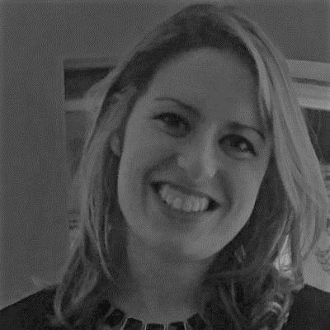

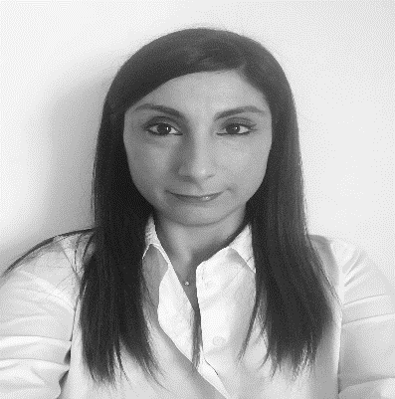





Team Composition
‘’Team is the key element for turning ideas into profitable business’’
MARCO BRAMBILLA
Tutor
Politecnico di Milano
CHARL MARAIS
Actuarial and
Data Manager
Europ Assistance Holding
MADDALENA GIACOLLO
Data Analyst
Generali Italia
MARIUS KRAPF
Actuary
Generali Deutschland AG
SIMONA SANTOLOCE
Data Analyst
Generali Investment Holding
CHRISTOPH BEQUET
System Engineer
Generali Shared Services
3

Slide 4










How we worked together
Organization of meetings schedule & agendas, involvement of attendees
Investigation one by one of all variables and handling of missing or outlier values
Definition a set of strategies for increasing retention and Client Lifetime Value (CLV)
Interpretation of twitters in terms of sentiment of words, polarity and subjectivity
1
Setup and Loading Data
3
Data Wrangling
5
Modelling
TIMELINES AND MILESTONES
Discussion of approach, activities, datasets and interdependencies
Optimization of datasets in terms of missing or incoherent values
Application of different models and use h2o to train several competing models
4
Exploratory Data Analysis
6
Business Case
0
Project Kick-off
2
Sentiment Analysis
Operative weekly check point
Sharing of documents
Definition of deadlines
Overall planning monitoring
Active comparison between team members as to leverage on different Capabilities and Professional Skills
MICROSOFT TEAMS
GITHUB
OUTLOOK
WHATSAPP
PROGRAMMING CODE
1
2
3
4
5
SUPPORTING TOOLS
4

Slide 5




Setup and Loading Data
Sales, CRM, Finance, Twitter
Highlights
The document outlines the main phases, prerequisites in order to reach the target solution for “Customer Retention prediction on a travel Agency”
A unique primary Key has been defined and we analysed each dataset (Sales, CRM, Finance and Twitter)
Variables can be divided into 3 different types : Numeric, Categorical, Date
Using different custom functions (PropFunc, PlotFreq, SmartGrouper, GetSeason) the analysis has been performed for all Datasets
DATASET
SALES: Service and Customers Information
FINANCE: Payment Information
TWITTER: Tweets of Customers
CRM: Customers Information
Sales Dataset
CRM Dataset
Finance Dataset
Twitter Dataset
Observations: 4148
Variables: 20
Key: ID_CRM
Observations: 4151
Variables: 12
Key: ID_FINANCE
Observations: 12706
Variables: 2
Key: ID_SALES
Observations: 4153
Variables: 24
Key: ID_SALES
5

Slide 6






Twitter Dataset 1/2
Sentiment Analysis
The Sentiment analysis has been performed on the scope of Twitter Dataset following the steps included in the workflow
1.
Import Data : Preliminary analysis on the dataset
2.
Removing Stop Word and Cleaning Data: Clean twitter dataset for removing English stopwords and applying Tokenize text. Then, removing punctuations, special characters, numerical values, special description words
Apply Lemmatization of nouns and verbs (LSA): Apply Normalization using Lemmatizer
3.
4.
Identification of relevant topics: Identification of the first 30 relevant topics and add the first 10 as features in the model
5.
Apply Vader: Apply function to quantify emotion within the twitter dataset
Calculation Polarity and Subjectivity:
Polarity : it assumes values between -1 (negative) and +1 (positive)
Subjectivity : it assumes values between subjective (0) or fact (+1)
6.

Slide 7
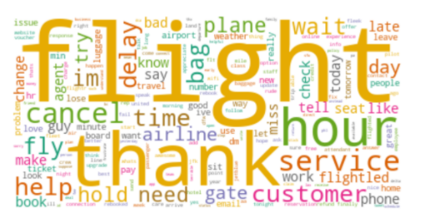
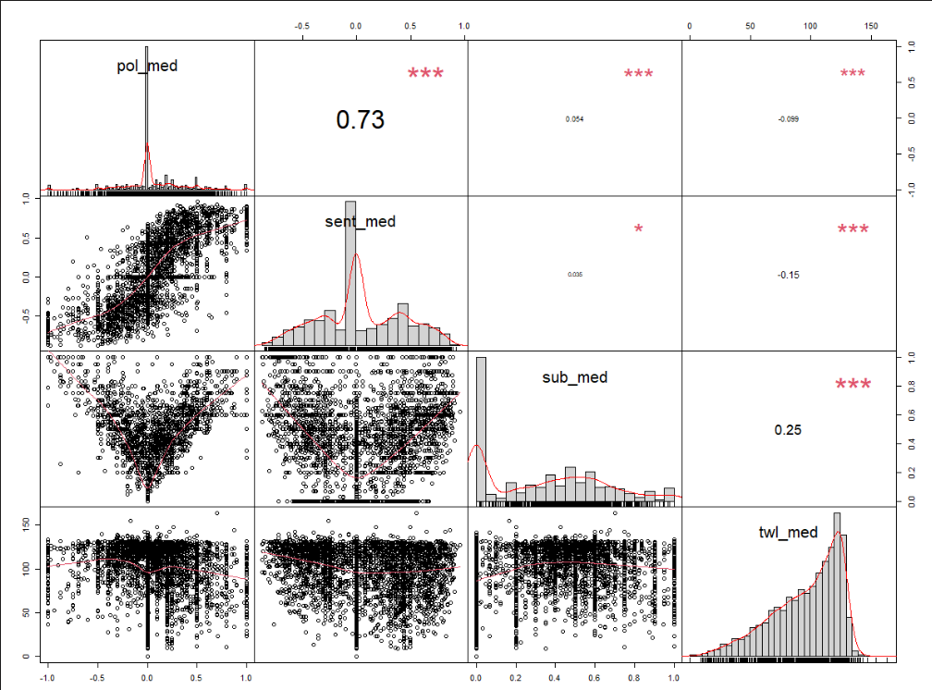
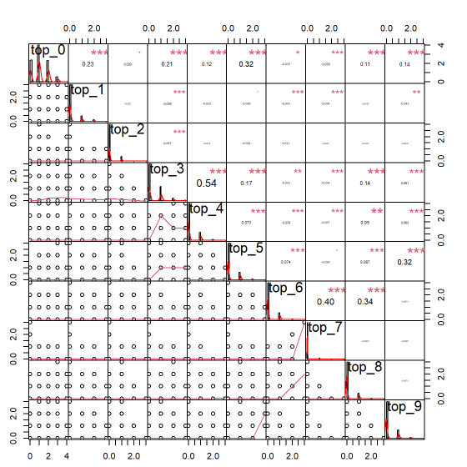
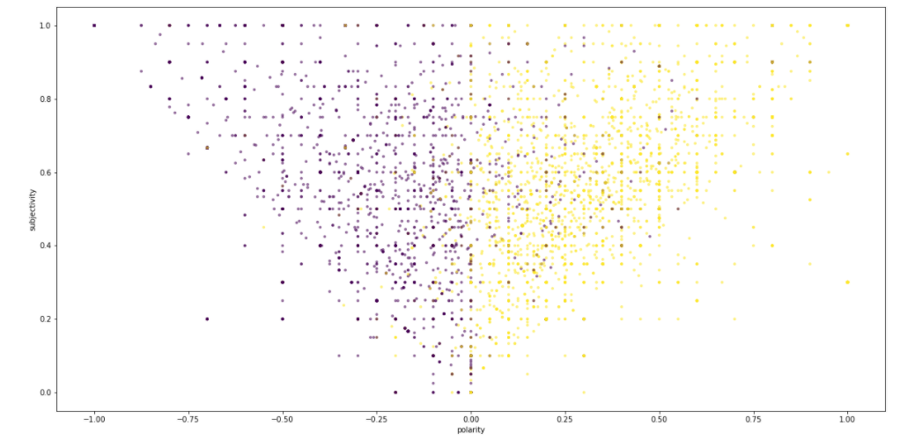
Twitter Dataset 2/2
Sentiment Analysis
RESULTS
MOST COMMON WORDS
DEPENDENCIES BETWEEN POLARITY AND SUBJECTIVITY
ID_SALES has been used for merging twitter and sales dataset and perform analysis on the retained clients
Prediction of polarity and subjectivity has a high impact on the Model
Polarity and Subjectivity are two relevant indicators for increasing the Customer retention
Low correlation between the 10 most relevant topics
Goals
FIRST TEN RELEVANT TOPICS
7
SUBJECTIVITY VS POLARITY

Slide 8


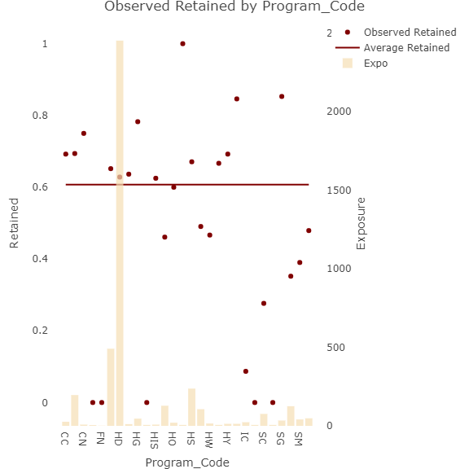
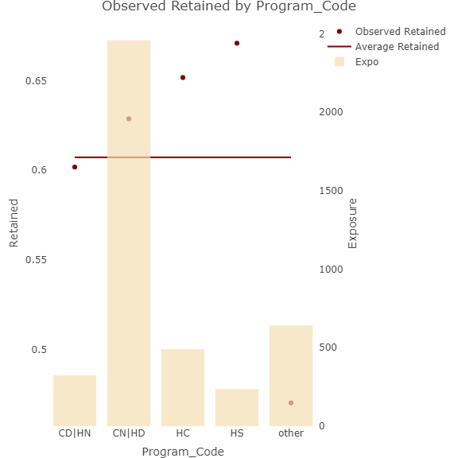
Exploratory Data Analysis (EDA)
Framework and focus on Program Code
Framework
Objective: the aim of the Exploratory Data Analysis (EDA) is to perform the following steps starting from the complete dataset:
Analysis for a single variable in the different datasets , excluding ID_SALES (Unique Key for each observation);
Remove redundant variables/highly correlated (FPP, Tuition, To_Grade, Cancelled_Pax, FRP_Active, Total_Discount_Pax, Num_of_non_FPP_PAX)
Verify correlation with target variable ‘’Retained’’;
Remove variables with low or zero variance (i.e Latest_RPL);
Please note that:
61% of all customers are Retained (value equal to 1, 0 otherwise)
Relationship between Program Code and target variable
Program Code
Program_Code describe the program code of the trip
Non-ordinal categorical variable
We used MCA to reduce the number of levels
Missing values: None
8

Slide 9
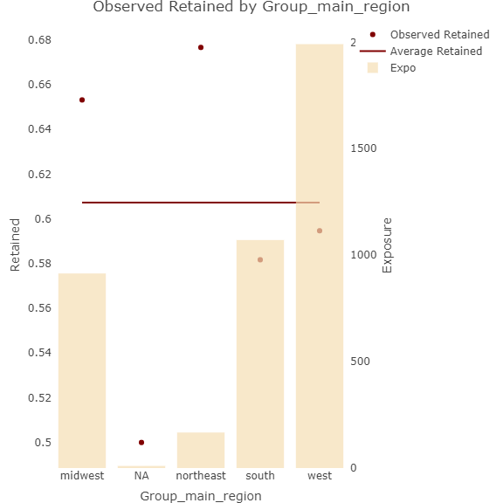
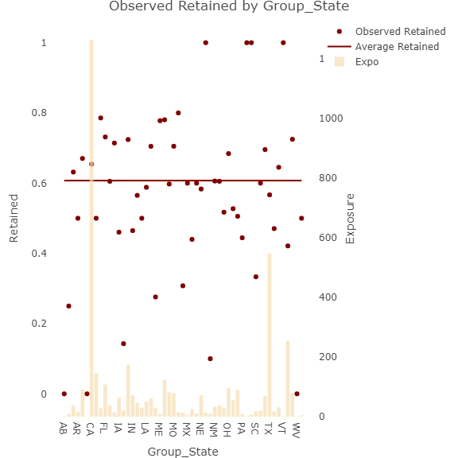
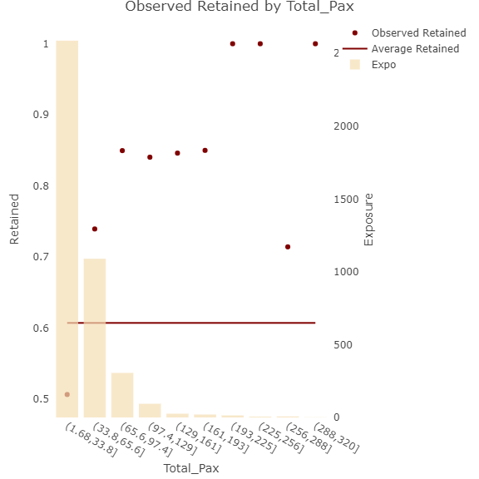
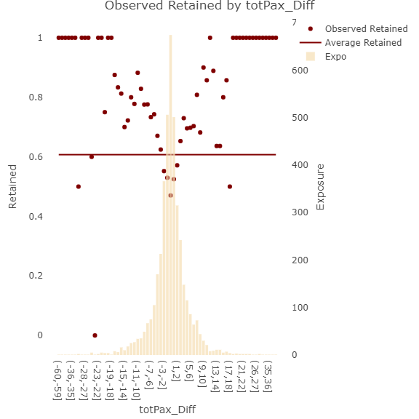
Exploratory Data Analysis (EDA)
Focus on Group State and Total PAX
Group State
Group State describe the school location
Grouping states based on their locations (northern, southern, eastern or western)
Group Missing values as Other
Relationship between Total PAX and target variable
Total PAX
Total_Pax: FPP (Full Payment Passengers) + totalDiscountPax (The number of extra passengers)
Numeric variable
Missing Values: None
TotPax_Diff calculated and added as feature into the model
High retention for biggest Groups
9

Slide 10
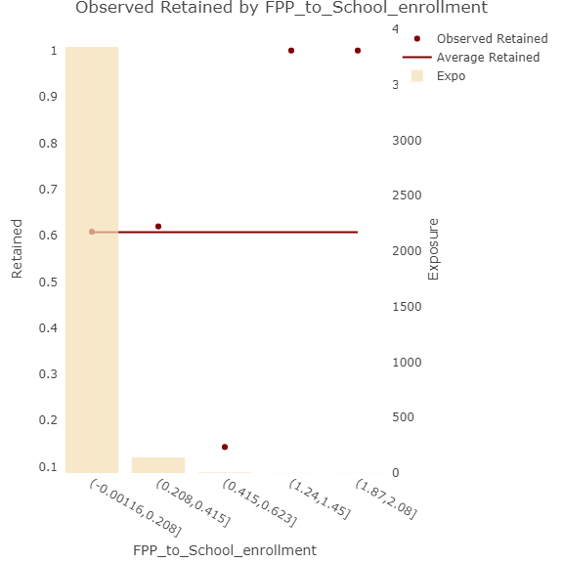
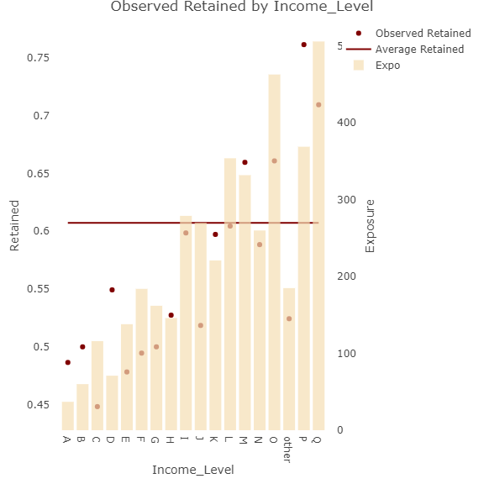

Exploratory Data Analysis (EDA)
Focus on FPP to School enrollment and Income Level
FPP School Enrollment
FPP_to_School_enrollment: the ratio of FPP (the number of Full payment passengers) to School Enrolments
Replace missing values with calculated values
School enrollment is positive correlated to the customer Retention
Relationship between Income Level and target variable
Income Level
Income_Level: Parent income level code. A is the lowest, Q is the highest and Z is unclassified
Missing values (0, NA and Z) classed as Other
High retention for costumers with higher Income Level
P1, P3,P4 and P5 are classified as P
10

Slide 11

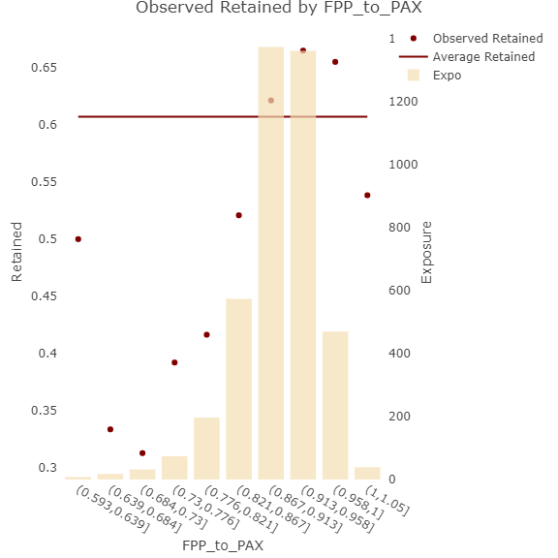
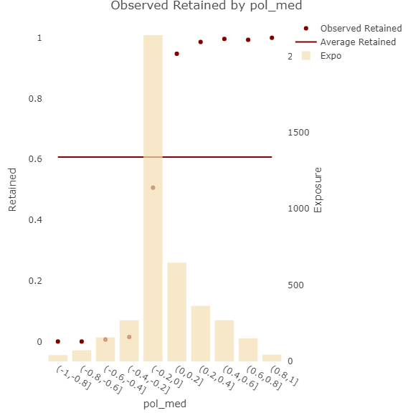
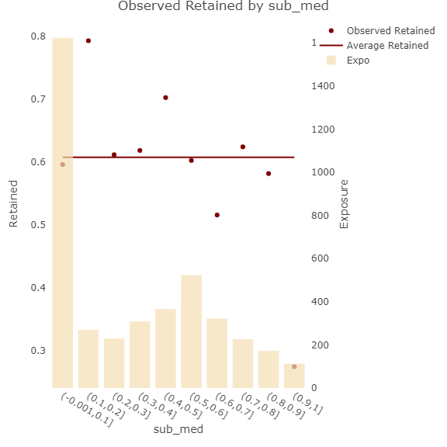
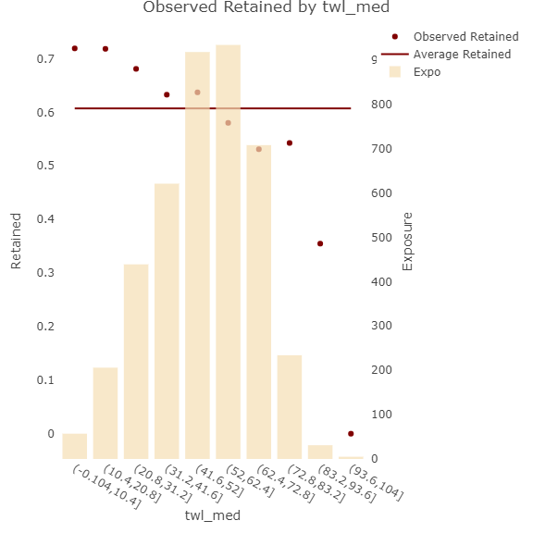

Exploratory Data Analysis (EDA)
Focus on FPP to PAX and Twitter
FPP To PAX
FPP_to_PAX: Percentage of FPP
Replace missing values with calculated values
FPP to PAX ratio is positive correlated to the customer Retention
Relationship between Twitter and target variable
Twitter
pol_med: median polarity of all the tweets from this individual
sub_med: median subjectivity of all the tweets from this individual
twl_med: median tweet length of all the tweets from this individual
Topics are not predictive and for this reason they are not part of analysis
11

Slide 12

Model development process
Framework and focus on models
Model Roadmap
Objective: the main achievement for the Model development is to perform a comparison between different models in order to define the best one based on the datasets
This analysis has been performed following the steps below on the final dataset:
Impute missing values for numeric features using PCA;
Standardize the data;
Train various models;
Stack these models;
Perform modeling in h2o to train several competing models (including stacking) using R and Python;
Choose a winning model based on the train set
GLM
NAÏVE BAYES
SVM
NEURAL NETWORK
GBM
Based on the maximum likelihood estimation via iteratively reweighed least squares
Parameters:
α and λ which are regularization parameters
Results :
Good result
Not over-fitting
Very high AUC and F1-score
Classification algorithm that relies on strong assumptions of the independence of covariates in applying Bayes Theorem
Parameters:
Laplace smoothing parameter
Results :
Very poor results
Can be formulated as a quadratic optimization problem
Parameters:
C used to control error and
γ give curvature weight of the decision boundary
Results:
Good model, but still not better than the GLM
No sign of overfitting
Multi-layer feed-forward artificial network that is trained with stochastic gradient descent using back-propagation.
Parameters:
Activation functions (tanh, rectifier and maxout)
L1 and L2 normalization
Results:
Overall good results, but still not better than GLM
Forward learning ensemble method
Parameters:
max_depth controls how deep the trees split
min_rows is the minimum number of observation we would like to have per final node
col_sample_rate is the column sampling parameters
sample_rate is the row sampling parameters
Results:
Best Model on the test set based on the F1-score
No overfitting
12

Slide 13
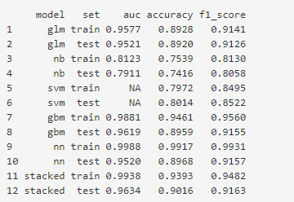
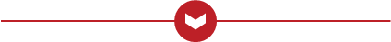
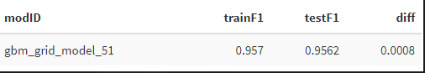
Model development process
Focus on models
Stacking
Compare models
Stacked Ensemble method is a supervised ensemble machine learning algorithm that finds the optimal combination of a collection of prediction algorithms using a process called stacking
Choose the 3 best models from GLM, GBM and NN and combine them
The stacked result increased the overall performance by 0.64 but over-fits the training data
The preferred model still remains GLM
H2O’s AutoML
Results
Can be used for automating the machine learning workflow, which includes automatic training and tuning of many models within a user-specified time-limit
Parameters: amount of time you would like it to run for (in seconds)
Trained over 1000 models
Calculate the F1-score on both the train and test set for each model trained
After applying H2O’s AutoML, the best model is GBM_grid__1_AutoML_20210323_032348_model_14
It produces the highest F1-score
There isn’t sufficient proof of over fitting
The Improvement of Polarity using TextBlob and the sentiment score with NLTK correct text classification
13

Slide 14

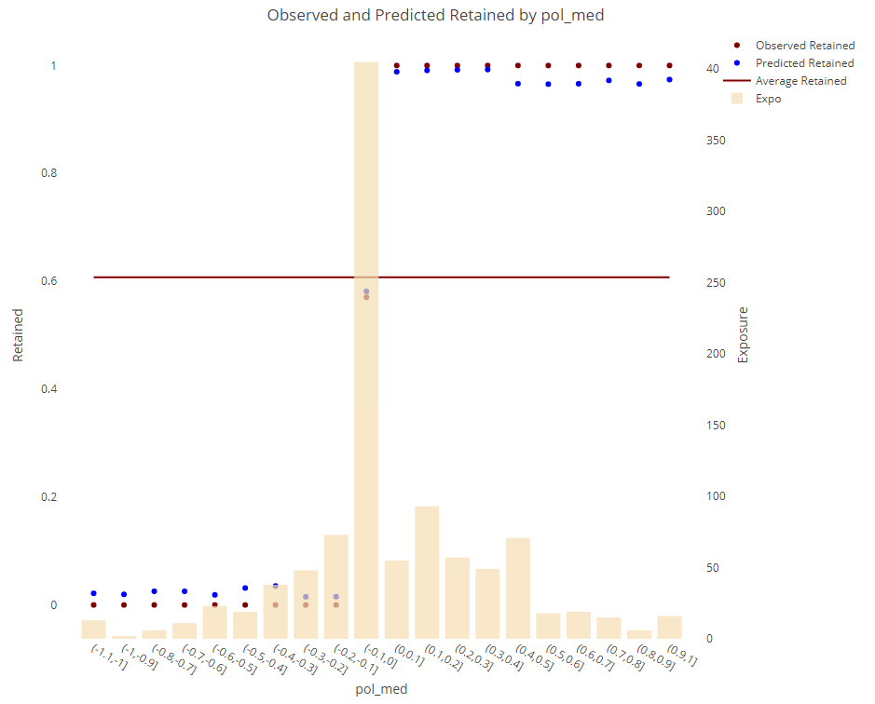
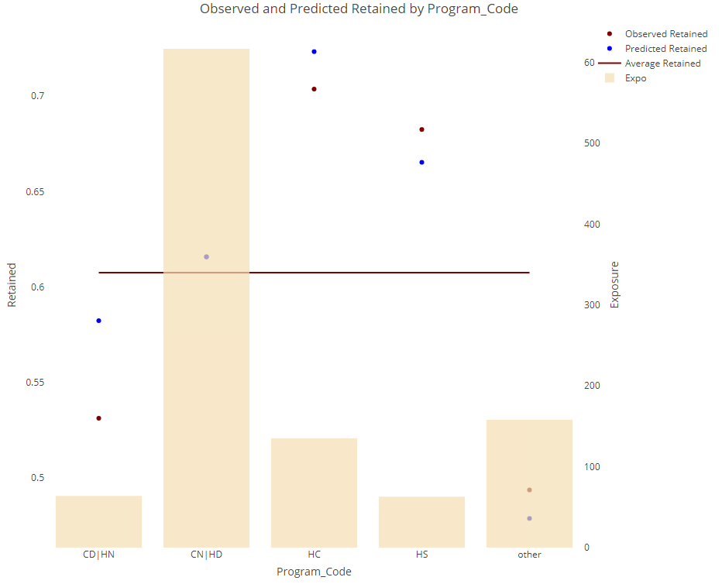
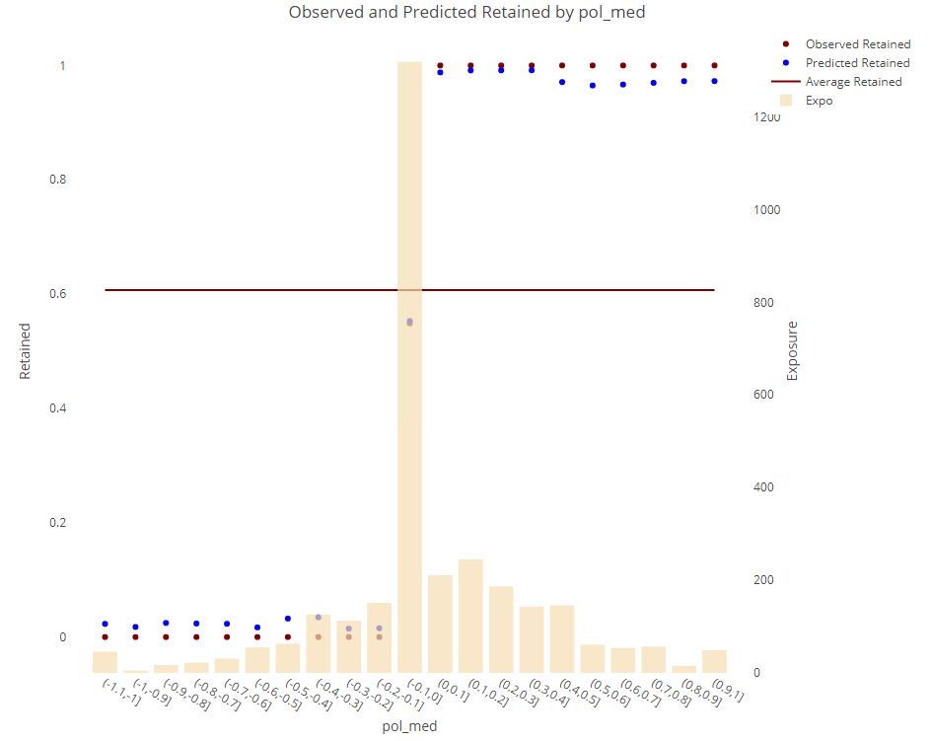
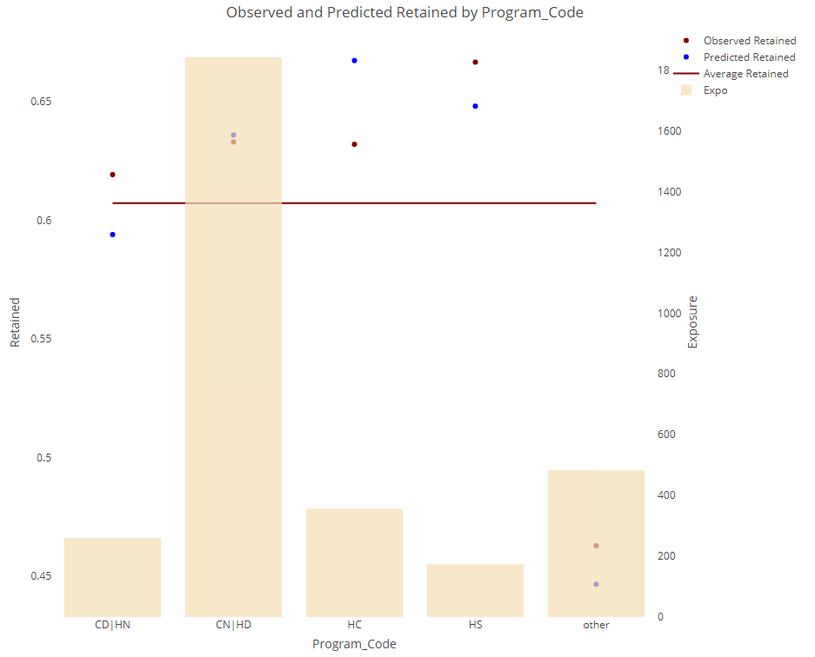

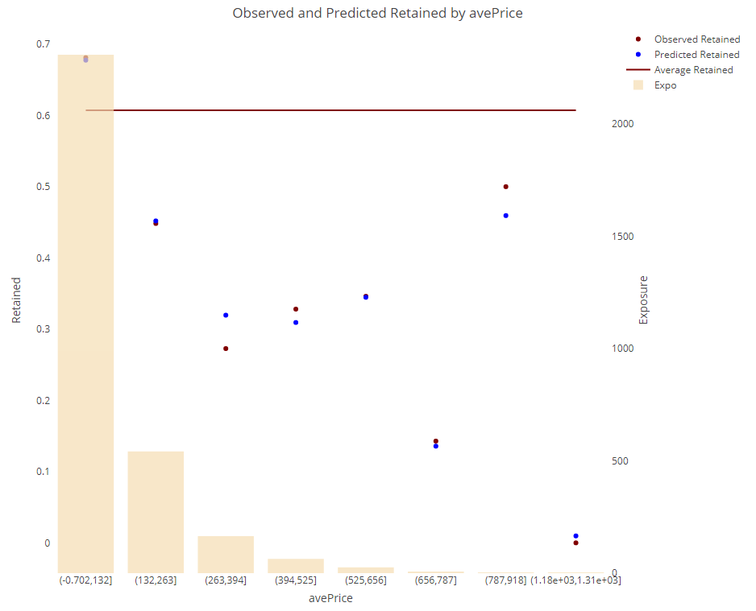
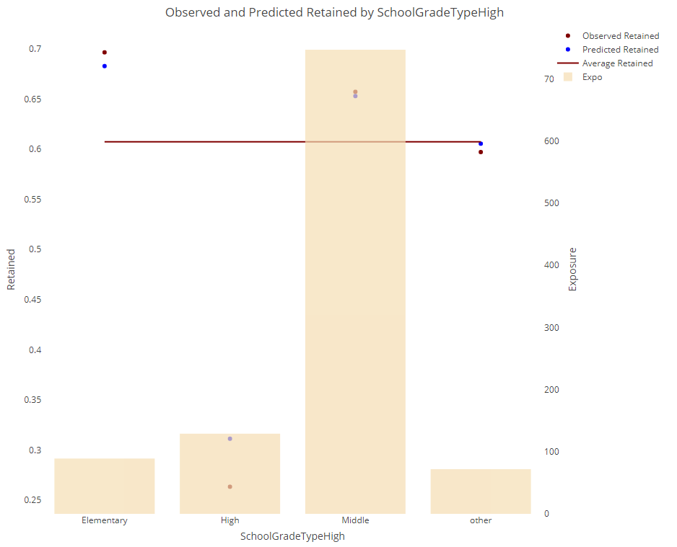
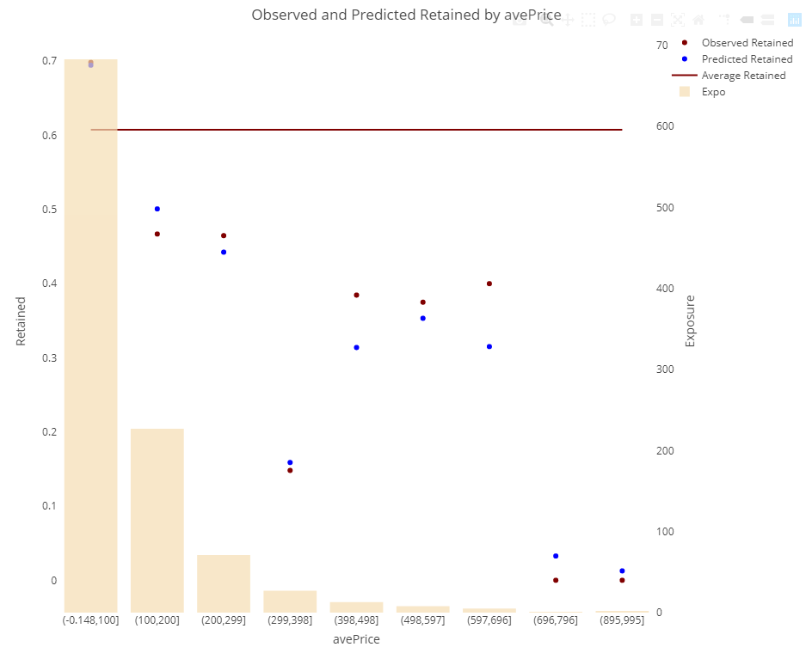
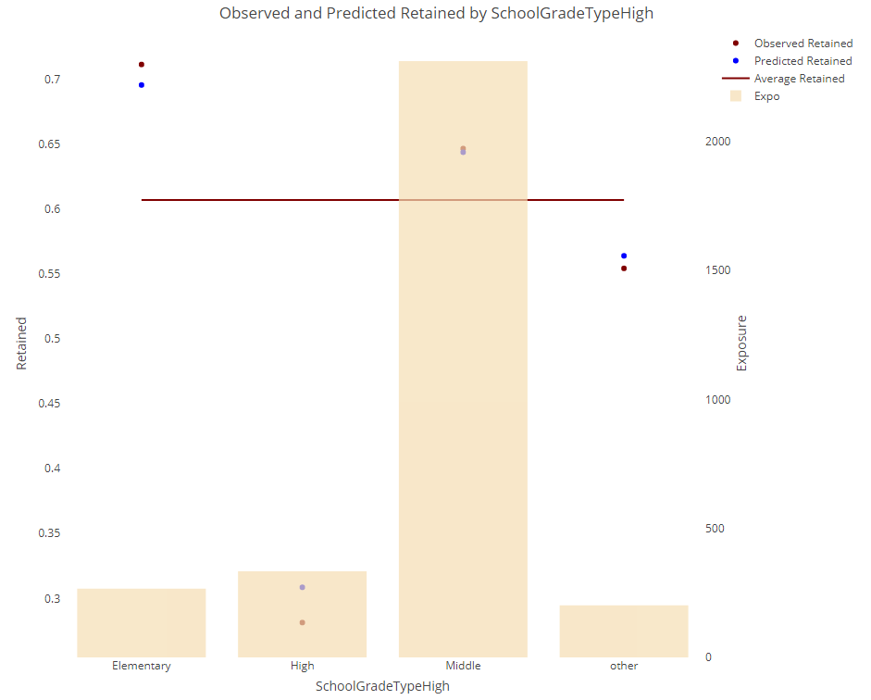
Model development process
How does the model perform by considering some variables?
POL_MED
PROGRAM_CODE
TEST
TRAIN
TEST
TRAIN
AVEPRICE
SCHOOLGRADETYPEHIGH
TEST
TRAIN
TEST
TRAIN
14

Slide 15





Business Case 1/2
Project Mission
Mission
The main goal to be achieved for the Customer retention is the Customer Lifetime Value (CLV) to ensure the retention for the most profitable clients
KEY ASSUMPTIONS
TARGET MODEL
Revenue
The generation of overall profit margin of 5%
Profit has defined also as a thresholder for implementing a strategy and actionable steps to achieve the strategic objective
SOCIAL MEDIA PRESENCE
Unprofitable Clients
Clients
Customer Retention
All Clients are Eligible to support the realization of the target operating model, especially large groups
Social Media channel is a strategic tool for monitoring Customer satisfaction
IMPROVE CUSTOMER OFFERING
Costs
Cost of trips doesn’t increase for Customers
TARGET SEGMENT

Slide 16
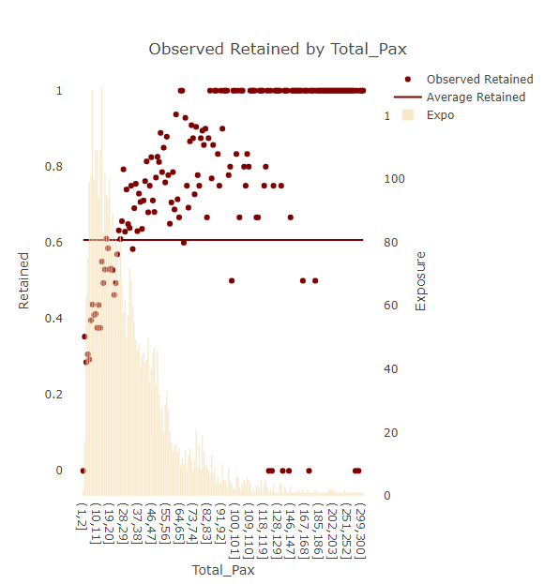
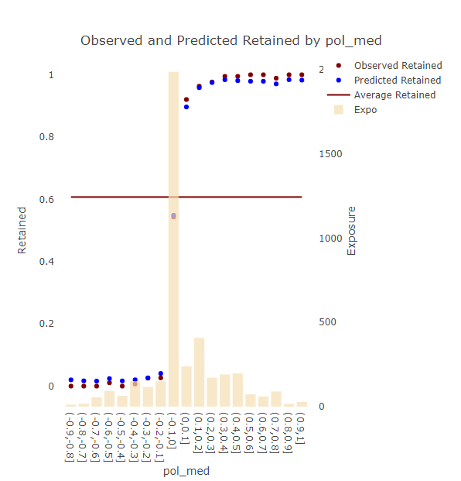
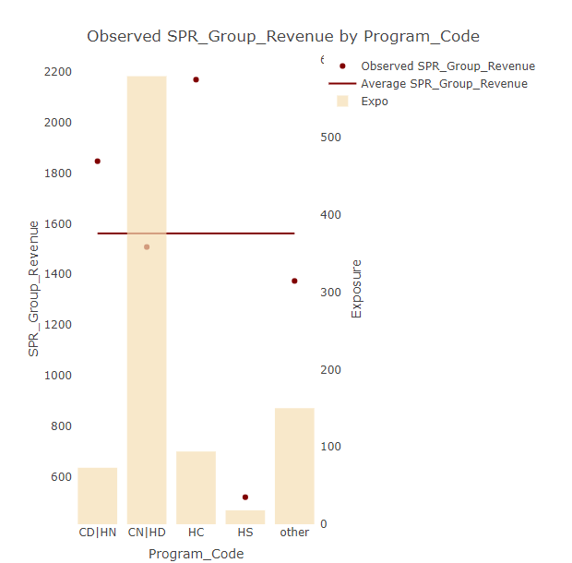

Business Case 2/2
Realization roadmap: apply the new service model leveraging on immediate initiatives
SOCIAL MEDIA PRESENCE
IMPROVE CUSTOMER OFFERING
TARGET SEGMENT
Introduction of BOT for checking the Twitter account and customer satisfaction
The polarity will be calculated for each Twitter with a Company Tag
The BOT will send and automatic message to the different clients based on the polarity of each Twitter
Special Offer or discounts can be offered to the unclassified clients
A new cheaper program will be offered to the customers with a low-income level
The correct program code has to be identified for each cluster of client based on the Income level
Groups with ≥30 People are the travel with the highest level of customer retention
A new service/Product should be developed by the company for merging different schools in the same travel
Company has active part in identifying new services/products based on market trends
Low-cost impact for the implementation of the BOT
A Financial loss can be evaluated for ensuring the retention of the most profittable clients
The best discount has to be defined for ensuring the optimal return
Offering Individual Discount can result in a 12% Retention Increase and 11,5% Profitability Increase up to 58% more for a 1% decrease in premium

Slide 17







TARGET MODEL FOR CUSTOMER RETENTION
Call to action
Discounts will be offered
Based on the polarity calculated by the BOT
To be
BOT
we are sorry to hear that you had a bad experience with us……
Ensure the correct Program code for each Income Level could improve the Customer retention roughly 3% and Profit 6%
Customer Offering
Target Segment
‘’The more the merrier”
Ensure accuracy, completeness and consistency for Polarity and Subjectivity grant a good results on the model prediction
17

Slide 18
Q&A
Thank you!

